Slide 1

Approaches to Data Analysis Health Outcomes Research Class 3 Sep 16, 2025
Wenhui (Vivian) Zhang, PhD, MS (Statistics),
Research Assistant Professor,
Nell Hodgson Woodruff School of Nursing, Emory University

Slide 2
Overview
Data Science
Data Quality
Data Cleaning
Data Analysis
Lab Session
Q&A

Slide 3
Substantive Expertise: Knowledge discovery, questions and hypotheses. Questions first, then data.
Hacking Skills: Data hackers must be able to manipulate text files at the command-line, thinking algorithmically, and be interested in learning new tools.
Math & Statistics Knowledge: Extract insight from cleaned data, apply appropriate math and statistics methods and tools.
Traditional Research: little time with technology
Danger Zone!: 'know enough to be dangerous,' what appears to be a legitimate analysis without any understanding of how they got there or what they have created
(Conway, 2010)
3
Notes:
https://s3.amazonaws.com/aws.drewconway.com/viz/venn_diagram/data_science.html

Slide 4
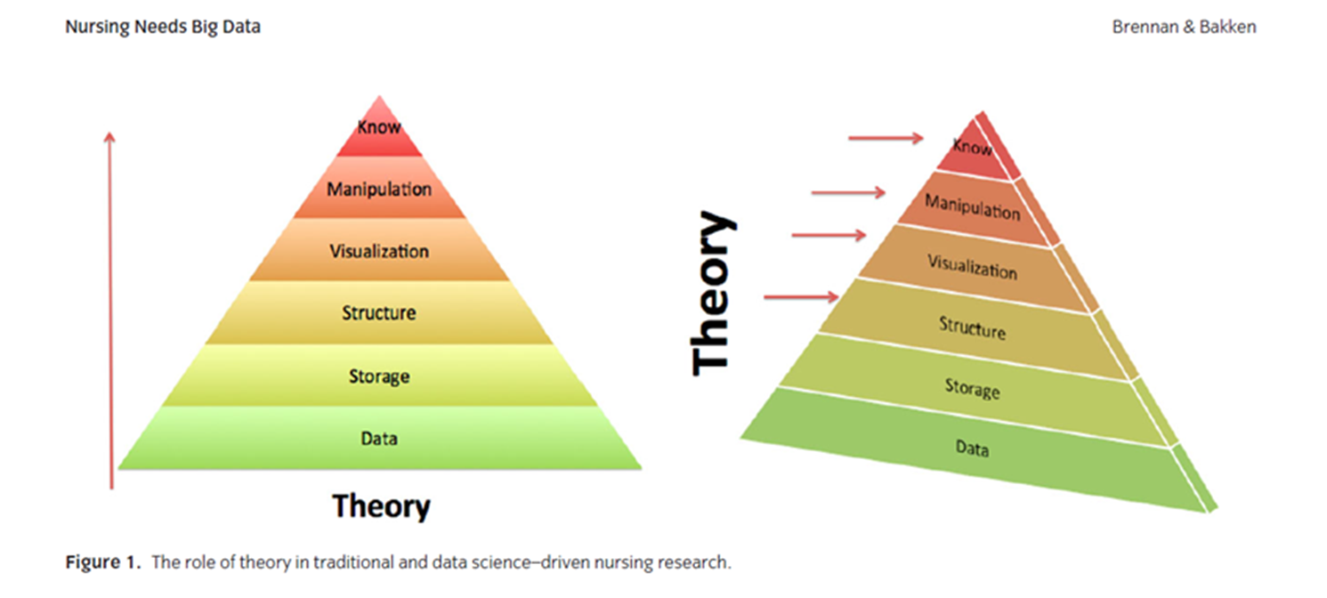
Nursing Needs Big Data
(Brennan & Bakken, 2015)
4
Notes:
Brennan PF, Bakken S. Nursing Needs Big Data and Big Data Needs Nursing. J Nurs Scholarsh. 2015 Sep;47(5):477-84. doi: 10.1111/jnu.12159. Epub 2015 Aug 19. PMID: 26287646.

Slide 5
Big data
“5Vs”: volume, variety, velocity, veracity, and value
Volume: size
Variety: diversity of data types
Velocity: speed
Veracity: truth, accuracy, reliability, validity
Value: answering questions
(Brennan & Bakken, 2015; Laney, 2001)
5
Notes:
Brennan PF, Bakken S. Nursing Needs Big Data and Big Data Needs Nursing. J Nurs Scholarsh. 2015 Sep;47(5):477-84. doi: 10.1111/jnu.12159. Epub 2015 Aug 19. PMID: 26287646.
Laney D. 3D data management: Controlling data volume, velocity and variety. META group research note. 2001 Feb 6;6(70):1.

Slide 6
Data Literacy
Data literacy: ability to read, understand, create, and communicate data as information.
Skills:
Computer skills, including manipulating spreadsheets and data bases;
Collecting, retrieving, and analyzing data and information to improve safety;
Protecting and safeguarding clients’ privacy and confidentiality;
Conducting online literature searches and tapping resources for evidence-based care;
Mastering web-based learning;
Accessing regulations for telehealth and virtual care delivery;
Applying nursing workload principles;
Utilizing electronic health records.
(American Association of Colleges of Nursing, 2008; Bergren & Maughan, 2020)
6
Notes:
American Association of Colleges of Nurses (AACN) (2008) The Essentials of Baccalaureate Education for Professional Nursing Practice. 1-62. http://www.aacn.nche.edu/education-resources/BaccEssentials08.pdf
Bergren MD, Maughan ED. Data and Information Literacy: A Fundamental Nursing Competency. NASN School Nurse. 2020;35(3):140-142. doi:10.1177/1942602X20913249

Slide 7
Quantitative literacy in nursing
Be Aware of What You Do and Don’t Know
Know How to Find Statistical Help
For PhD-prepared Nurses, Seek Challenging Learning Opportunities
Focus on Quantitative Literacy Rather Than Statistical Expertise
Advance Efforts to Increase Quantitative Literacy in Nursing
Notes:
Schroeder K, Dumenci L, Sarwer DB, Wheeler DC, Hayat MJ. Increasing quantitative literacy in nursing: A joint nursing-statistician perspective. J Adv Nurs. 2022 Apr;78(4):e66-e68. doi: 10.1111/jan.15150. Epub 2022 Jan 6. PMID: 34989421; PMCID: PMC8901543. https://www.ncbi.nlm.nih.gov/pmc/articles/PMC8901543/

Slide 8
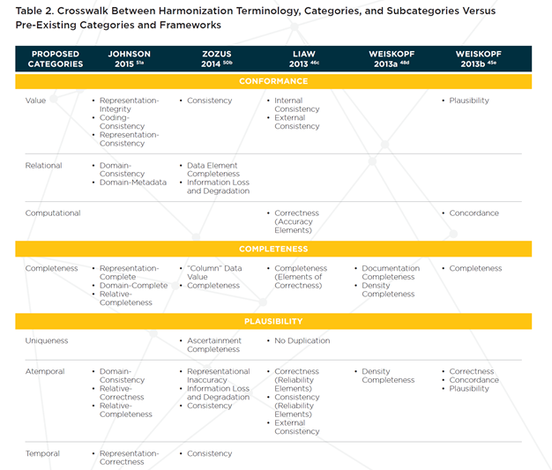
Data Quality
Sampling
Participant
Measurement
Interviewer
Scale items
Not applicable/Skips
Design
Time/Workflow
Attrition
Documentation quality
Analysis
Missing data
Accuracy
(Kahn et al., 2016)
8
Notes:
Kahn MG, Callahan TJ, Barnard J, Bauck AE, Brown J, Davidson BN, Estiri H, Goerg C, Holve E, Johnson SG, Liaw ST, Hamilton-Lopez M, Meeker D, Ong TC, Ryan P, Shang N, Weiskopf NG, Weng C, Zozus MN, Schilling L. A Harmonized Data Quality Assessment Terminology and Framework for the Secondary Use of Electronic Health Record Data. EGEMS (Wash DC). 2016 Sep 11;4(1):1244. doi: 10.13063/2327-9214.1244. PMID: 27713905; PMCID: PMC5051581.

Slide 9
Harmonized Data Quality Assessment Terminology and Framework
Secondary use of EHR data
Conformance: whether the dataset’s reported values meet structural standards and formats
Completeness: whether or not the data are actually presented
Plausibility (i.e., accuracy): if the data values are believable and accurate
(Kahn et al., 2016)
Notes:
Kahn MG, Callahan TJ, Barnard J, Bauck AE, Brown J, Davidson BN, Estiri H, Goerg C, Holve E, Johnson SG, Liaw ST, Hamilton-Lopez M, Meeker D, Ong TC, Ryan P, Shang N, Weiskopf NG, Weng C, Zozus MN, Schilling L. A Harmonized Data Quality Assessment Terminology and Framework for the Secondary Use of Electronic Health Record Data. EGEMS (Wash DC). 2016 Sep 11;4(1):1244. doi: 10.13063/2327-9214.1244. PMID: 27713905; PMCID: PMC5051581.

Slide 10
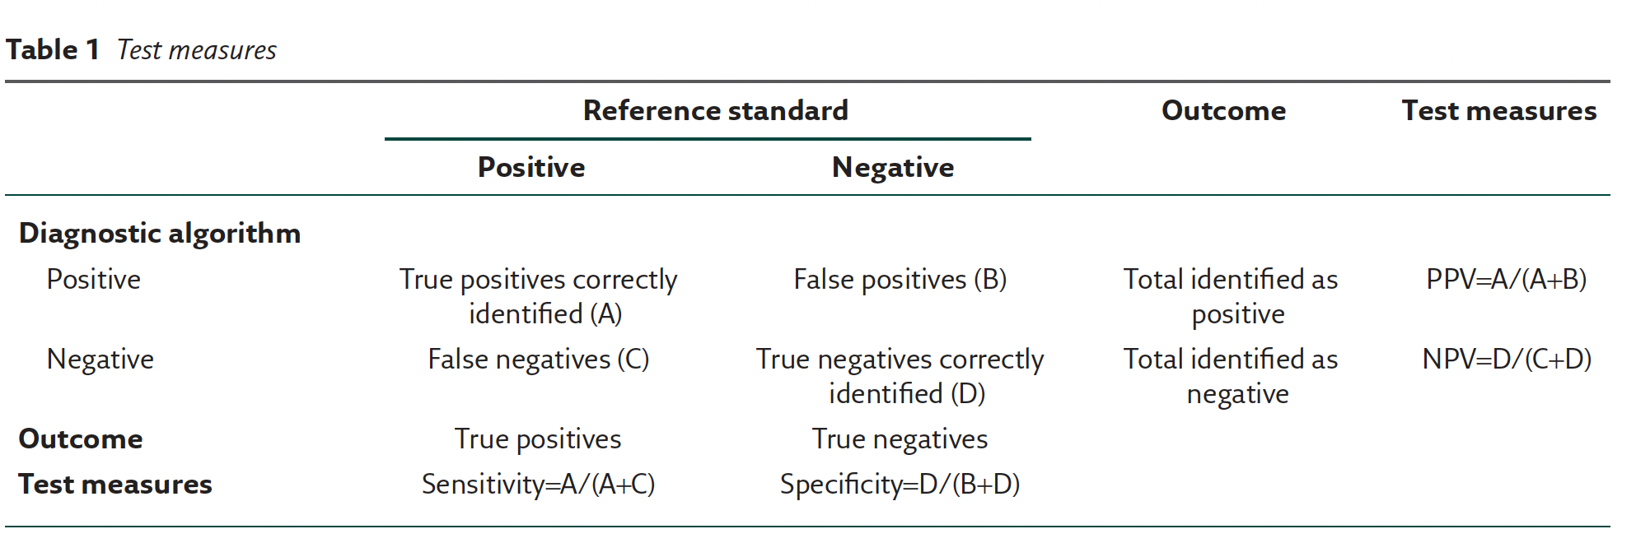
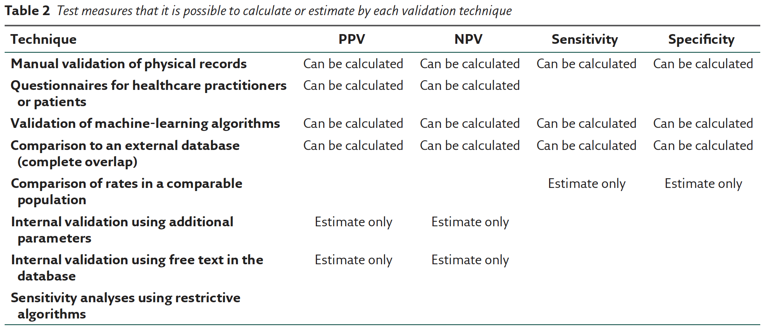
How to validate a diagnosis recorded in electronic health records?
Notes:
Nissen F, Quint JK, Morales DR, Douglas IJ. How to validate a diagnosis recorded in electronic health records. Breathe (Sheff). 2019 Mar;15(1):64-68. doi: 10.1183/20734735.0344-2018. PMID: 30838062; PMCID: PMC6395976. https://www.ncbi.nlm.nih.gov/pmc/articles/PMC6395976/

Slide 11
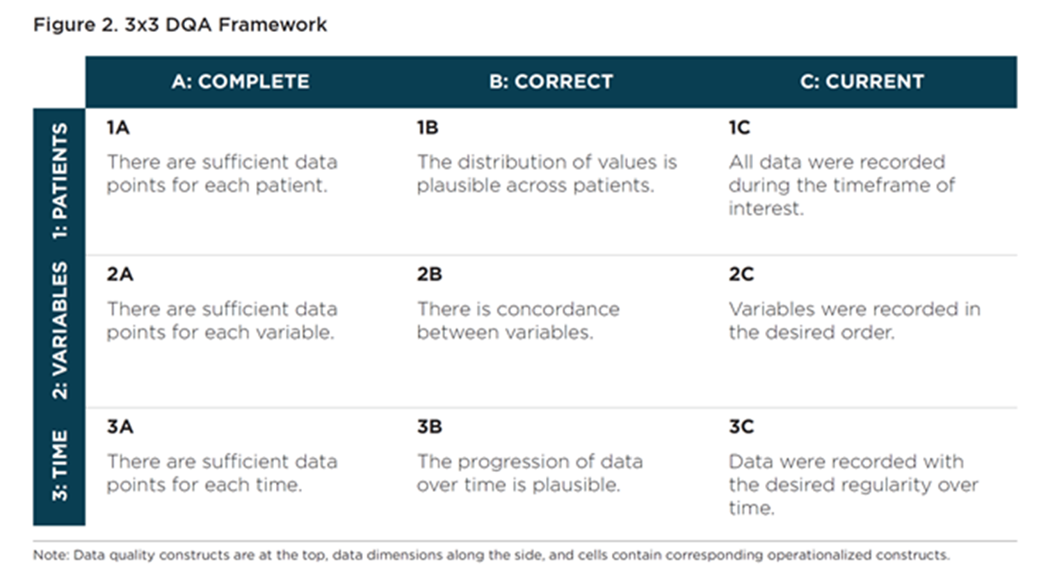
Data Quality: EHRs
(Weiskopf et al., 2017)
11
Notes:
Weiskopf NG, Bakken S, Hripcsak G, Weng C. A Data Quality Assessment Guideline for Electronic Health Record Data Reuse. EGEMS (Wash DC). 2017 Sep 4;5(1):14. doi: 10.5334/egems.218. PMID: 29881734; PMCID: PMC5983018.

Slide 12
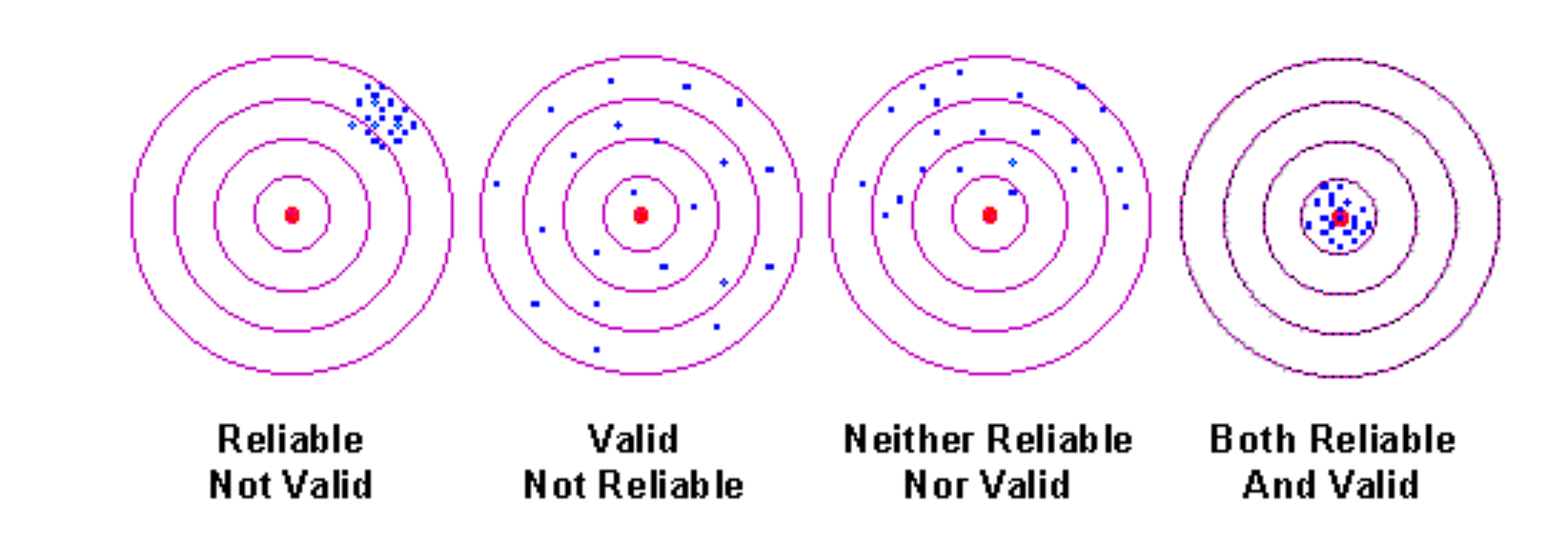
Data Quality: Reliability, Validity
Internal reliability, other reliabilities?
Reverse coded items?
How about validity?
RQ?
Example?
https://conjointly.com/kb/ (Trochim, 2022)
12

Slide 13
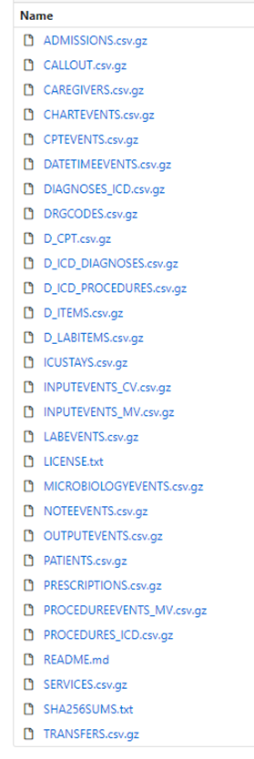
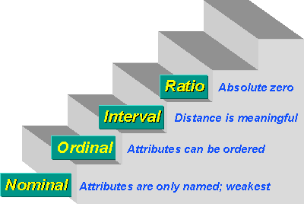
Data Cleaning
Data matching: join (inner, outer, left, right), uniqueness
Data
Cases: identity, inclusion/exclusion criteria, weight
Variables: continuous vs. categorical, nominal, binary, dichotomous, ordinal, interval, ratio, count, scale (reliability, validity, sub/total), date, outlier/extreme values, floor/ceiling effects, missing
Time: long, wide, restructure, aggregate
Transformation:
Compute: scale total score, normalization
Recode
Missing
Shift values
https://conjointly.com/kb/ (Trochim, 2022)
13

Slide 14
Data Analysis Approaches
Research questions?
Software (Excel/SPSS/SAS/R): version, data, package, syntax/script, output
Descriptive statistics
Chi square, odds ratio, relative risk
T-test, ANOVA
Correlation, scale internal reliability
Non-parametric tests
Regression (linear, logistic, cox…)
Multivariate modeling
Multilevel modeling
Meta-analysis
Machine learning
14

Slide 15
Data Visualization
Graphs and Plots
Descriptive: histogram, box plot, line chart…
Pattern discovery: heat map
Results: regression, RMANOVA
15

Slide 16
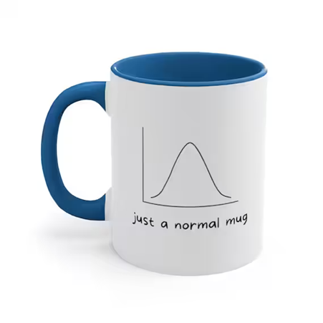
Descriptive statistics
Sample size, frequency, percentile, missing
Mean, variance, standard deviation
Median, quartiles
Mode, sum
Minimum, maximum, range
Distribution, normality
Skewness, kurtosis
Outlier, extreme values
16

Slide 17
Normality
Skewness, Kurtosis, Standard Error: Skewness vs. +-2SE etc.
Plots: histogram, Q-Q plot
Tests: Kolmogorov-Smirnov Test and the Shapiro-Wilk Test
Outlier: 2/3 +-SD
Transformation: log…
17

Slide 18
Missing
Completely at random
At random
Not at random
Little's Missing Completely at Random (MCAR) Test
Imputation? Mean/median substitution, multiple imputation, intention-to-treat…
18
Notes:
https://www.ncbi.nlm.nih.gov/pmc/articles/PMC4121561/
https://stefvanbuuren.name/fimd/sec-MCAR.html

Slide 19
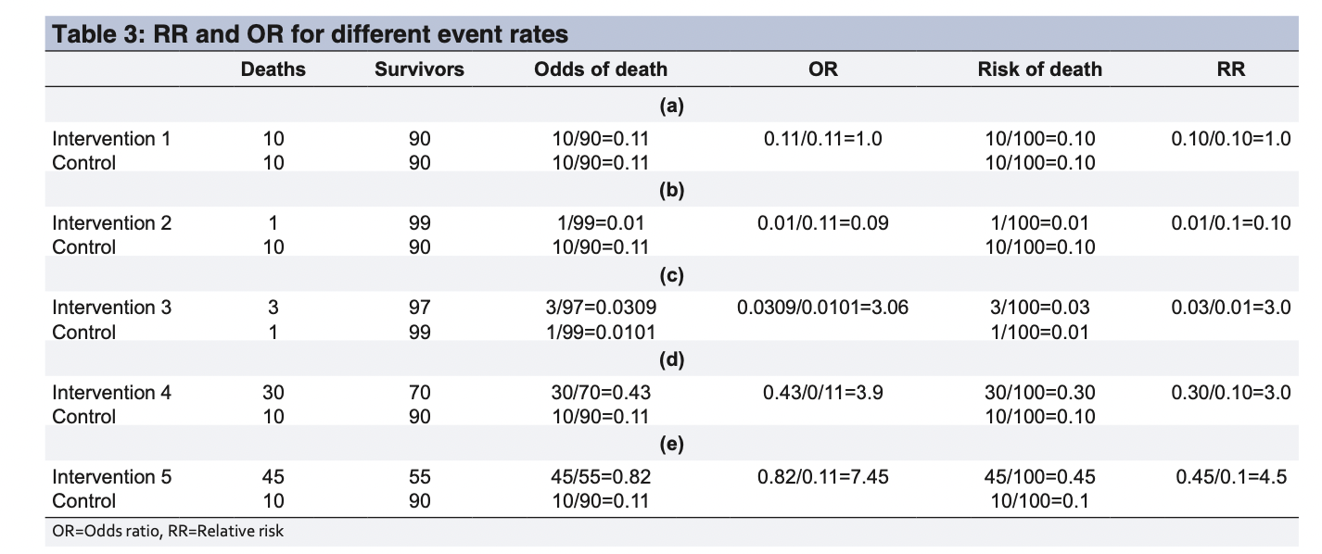
Crosstab, contingency table
19

Slide 20
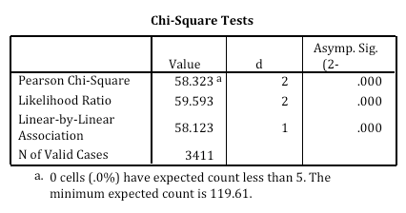
Chi-square test
Question: whether observed data differ from theoretical expectations (expected versus observed frequency), goodness of fit; whether categorical variables A and B are independent (not related/associated), homogeneity, test of significant difference between two proportions
Hypothesis:
H0: The die is fair as expected or A and B are not related/associated (independent)
H1: The die is not fair as expected or A and B are related/associated (not independent)
Assumptions:
Frequencies/counts, not too small
Variable categories are mutually exclusive
Strength of association: relative risk, odds ratio
20

Slide 21
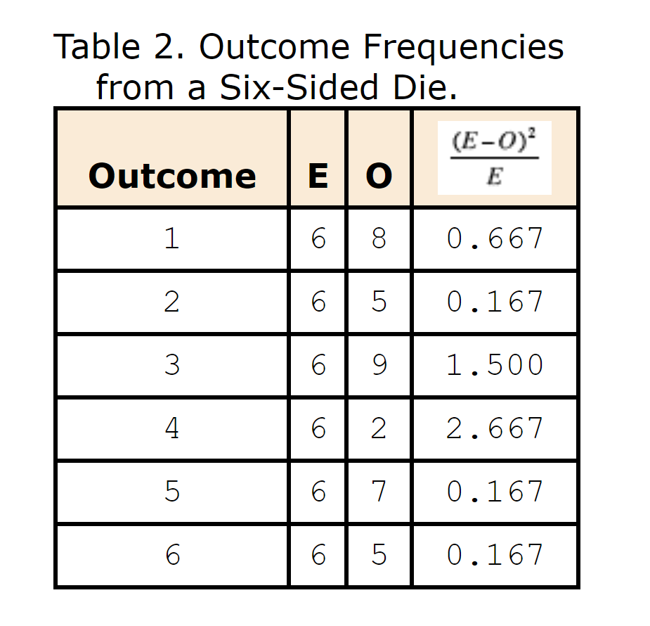
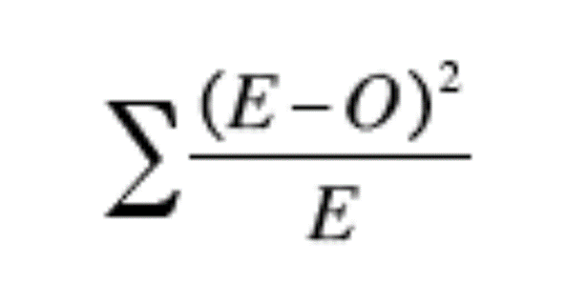
Chi-square test
21
Notes:
36 times

Slide 22
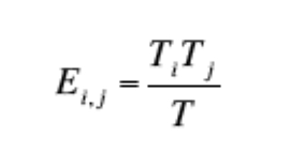
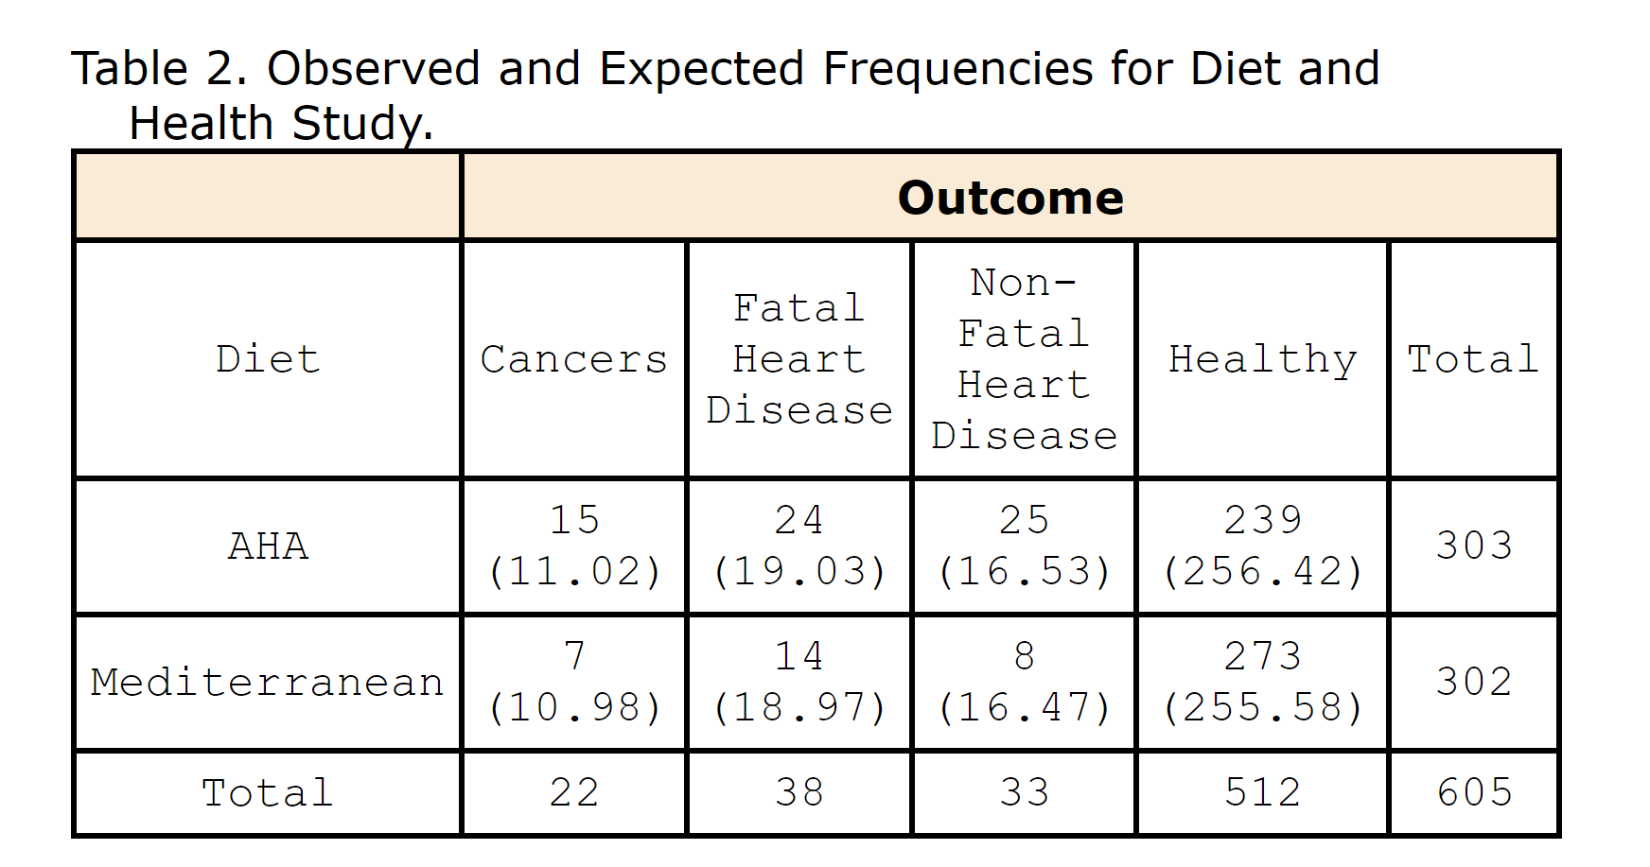

Chi-square test
22

Slide 23
Relative Risk and Odds Ratio
Wenhui (Vivian) Zhang, PhD, MS (Statistics),
Research Assistant Professor,
Nell Hodgson Woodruff School of Nursing, Emory University

Slide 24
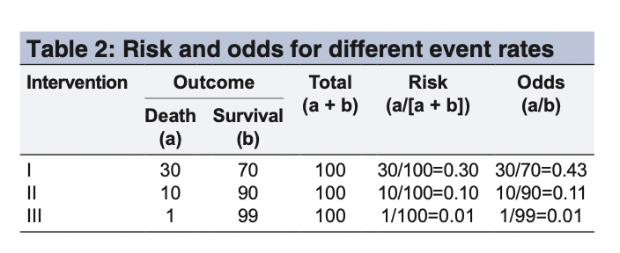
Risk and Odds?
Risk: the probability of occurrence of an event or outcome. Statistically, risk = chance of the outcome of interest/all possible outcomes
Odds: the probability of occurrence of an event/probability of the event not occurring
Strength of association
Effect of exposure/risk
Effect of treatment based on outcome
Relative Risk
Odds Ratio
Research Design and Question?
Prospective studies (cohort studies), where the number at risk (number exposed) is available, either RR or OR can be calculated.
Retrospective (case‐control) studies: total number of exposed people unavailable, RR cannot be calculated and OR as a measure of the strength of association between exposure and outcome
Logistic regression: adjusted ORs
(Ranganathan et al., 2015)
24
Notes:
Ranganathan P, Aggarwal R, Pramesh CS. Common pitfalls in statistical analysis: Odds versus risk. Perspect Clin Res. 2015 Oct-Dec;6(4):222-4. doi: 10.4103/2229-3485.167092. PMID: 26623395; PMCID: PMC4640017.

Slide 25
Relative Risk and Odds Ratio?
RR: ratio of risk of an event in one group (e.g., exposed group) versus the risk of the event in the other group (e.g., nonexposed group)
OR: ratio of odds of an event in one group versus the odds of the event in the other group
(Ranganathan et al., 2015)
25
Notes:
Ranganathan P, Aggarwal R, Pramesh CS. Common pitfalls in statistical analysis: Odds versus risk. Perspect Clin Res. 2015 Oct-Dec;6(4):222-4. doi: 10.4103/2229-3485.167092. PMID: 26623395; PMCID: PMC4640017.

Slide 26
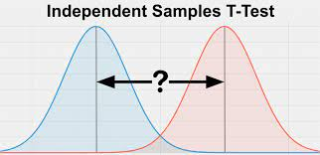
T-test
Question: whether the mean differ from each other (one sample mean versus expected, two groups – independent, paired)
Hypothesis:
One-sample: H0: μ1= hypothesized mean; H1: μ1≠ expected mean
Two-sample independent t-test: H0: μ1=μ2; H1: μ1≠ μ2
Paired t-test (pre/post, dyads): H0: μ1=μ2; H1: μ1≠ μ2
Assumptions:
Sample size
Level of measurement, continuous
Independence/paired of observations
Normal distribution
Homogeneity of variances assumed or not
26

Slide 27
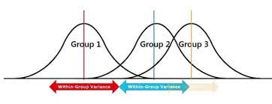
ANOVA
Question: whether the mean differ from each other (three or more groups)
Hypothesis: H0: μ1=μ2=...=μk; H1: at least one of the means is different
Assumptions:
Sample size
Level of measurement, continuous
Independence of observations
Normal distribution
Homogeneity of variances
Post-hoc analysis
Factorial ANOVA, MANOVA, ANCOVA, repeated measures ANOVA
27

Slide 28
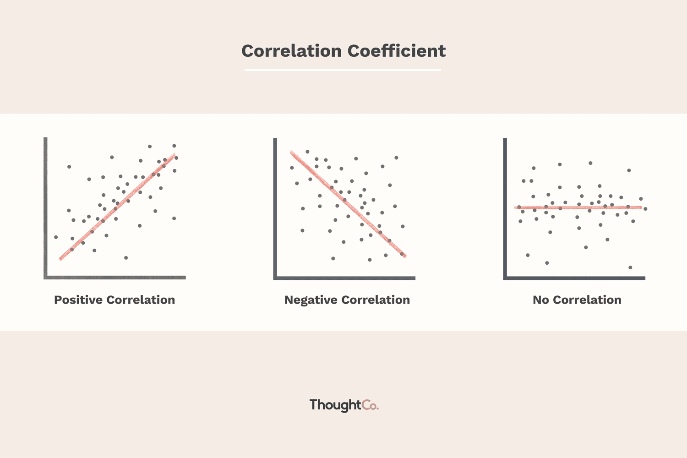
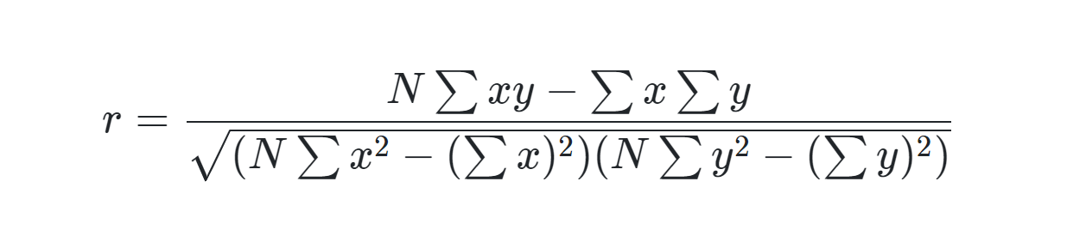
Correlation
Question: Are A and B related/associated?
What’s the direction/degree of the linear relationship?
Hypothesis: H0: r = 0; H1: r ≠ 0
Assumptions:
Level of measurement, related pairs, absence of outliers, and linearity
Pearson's correlation: interval/ratio
Spearman’s correlation: ordinal
28

Slide 29
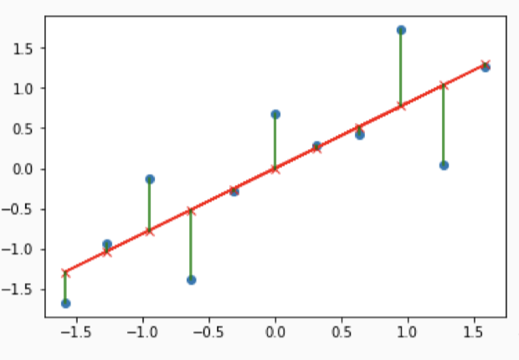
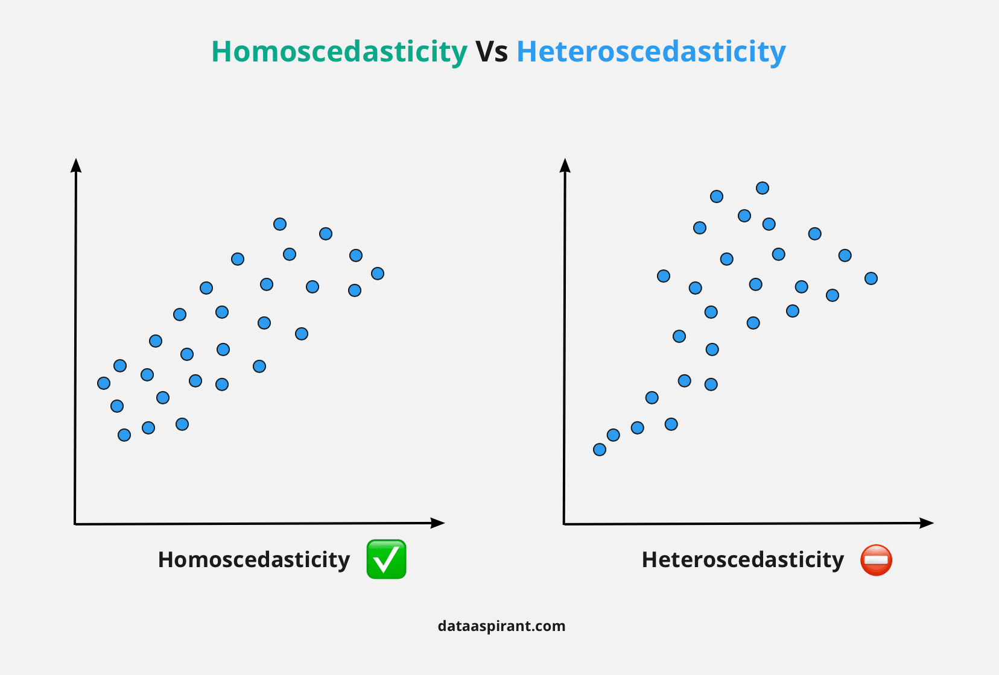
Regression
Question: predict Y with X (X1, X2…), dependent/independent variable?
Simple Linear Regression: y=bx+ a+ error (b: slope, a: intercept)
Logistic Regression: log odds=a +bx +error
Others: Multiple linear regression, general linear model, Poisson, non-linear
Hypothesis: H0: b=0; H1: b≠0
R square, F-test, t-test of coefficients
Assumptions: Simple linear regression
Independence of observations
Level of measurement, continuous
Normal distribution?
Linear relationship
Homoscedasticity
Residuals are normally distributed
29

Slide 30
Nonparametric tests (distribution free)
Median, rank
Mann-Whitney U test (One sample t-test)
Wilcoxon Rank Sum test (Two-sample t-test)
Kruskal-Wallis test (ANOVA)
Fisher's Exact Test
Spearman’s correlation
30

Slide 31
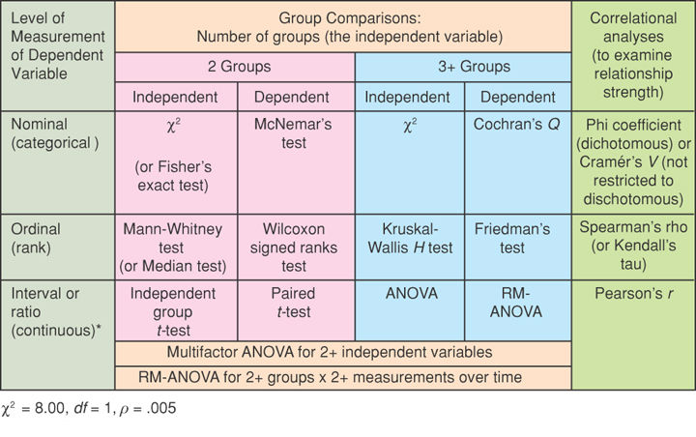
Quick Guide to Bivariate Statistical Tests
Polit & Beck, 2008. Nursing Research (8th ed).

Slide 32
EXCEL
Basic Statistical Analysis in Excel: http://www.bikeprof.com/uploads/9/0/6/5/9065192/excel_stats_handout_npl.pdf
Analysis ToolPak: https://www.excel-easy.com/data-analysis/analysis-toolpak.html

Slide 33
SPSS
Data
Syntax
Output
LinkedIn: https://www.linkedin.com/learning/spss-statistics-essential-training-2/logistic-regression?u=2149178
YouTube: https://www.youtube.com/c/ProfAndyField
UTAustin: https://stat.utexas.edu/images/SSC/documents/SoftwareTutorials/SPSS_DescriptiveInferential.pdf
UCLA: https://stats.idre.ucla.edu/other/mult-pkg/whatstat/
SPSS: https://www.ibm.com/support/pages/ibm-spss-statistics-28-documentation#en
33

Slide 34
SAS
Data Table
Editor
Log
Result Viewer
UTAustin: https://stat.utexas.edu/images/SSC/documents/SoftwareTutorials/SAS_Analyst.pdf
https://stat.utexas.edu/images/SSC/documents/SoftwareTutorials/SAS_InferentialStats.pdf
UCLA: https://stats.idre.ucla.edu/other/mult-pkg/whatstat/
SAS: https://support.sas.com/en/documentation.html
34

Slide 35
R, Rstudio?
Script
Console
Environment
Files/Plots/Packages
Rcmdr
Rattle
Rmarkdown
UCLA: https://stats.idre.ucla.edu/other/mult-pkg/whatstat/
Quick-R: https://www.statmethods.net/
Rstudio: https://www.rstudio.com/resources/cheatsheets/
35

Slide 36
Other resources
Emory's list of recommendations https://guides.libraries.emory.edu/main/Data_Services/statspackage_links
Discovering Statistics: https://www.discoveringstatistics.com/

Slide 37
Lab session
Have fun! Table 1?
More resources under recommended reading

Slide 38
Steps
Data Science: research question, dataset, potential analysis
Data Quality: background literature review, data collection
Data Cleaning: raw data, cleaned data
Data Analysis: assumptions, syntax, output, diagnostics
Results: table/figures
Discussion: interpretation, sample demographics, test p-value, effect size, sensitivity analysis etc.
38

Slide 39
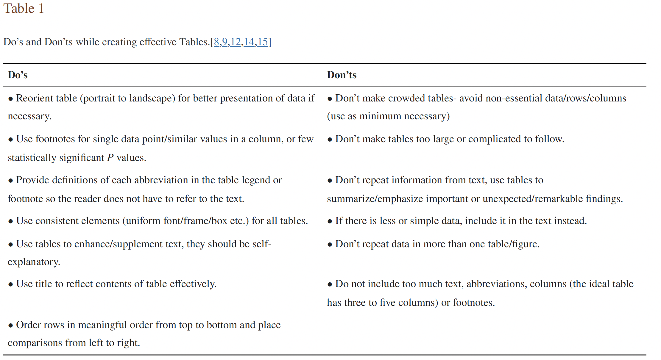
Notes:
Inskip H, Ntani G, Westbury L, Di Gravio C, D'Angelo S, Parsons C, Baird J. Getting started with tables. Arch Public Health. 2017 Mar 20;75:14. doi: 10.1186/s13690-017-0180-1. PMID: 28321295; PMCID: PMC5357815. https://www.ncbi.nlm.nih.gov/pmc/articles/PMC5357815/Links to an external site.
Divecha CA, Tullu MS, Karande S. Utilizing tables, figures, charts and graphs to enhance the readability of a research paper. J Postgrad Med. 2023 Jul-Sep;69(3):125-131. doi: 10.4103/jpgm.jpgm_387_23. PMID: 37395532; PMCID: PMC10394528. https://pubmed.ncbi.nlm.nih.gov/37395532/Links to an external site.

Slide 40
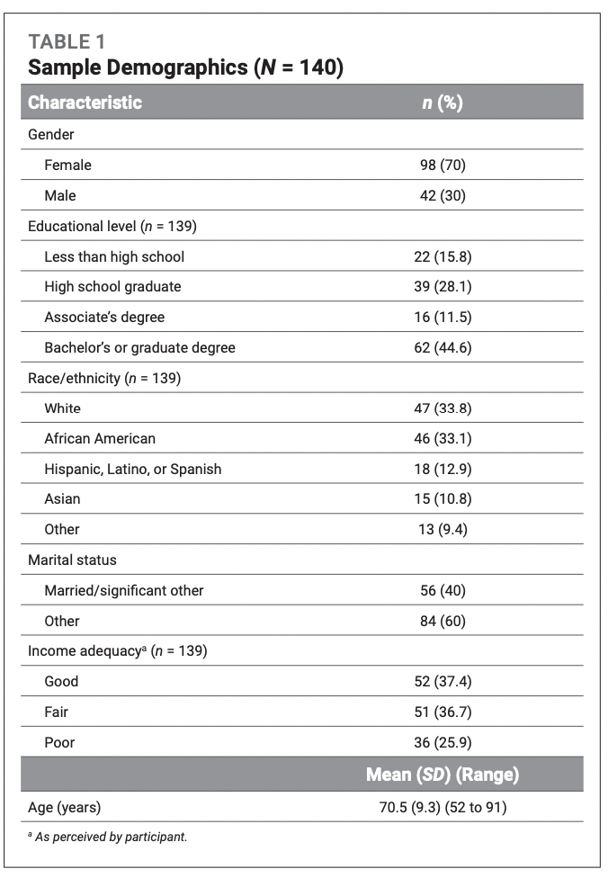
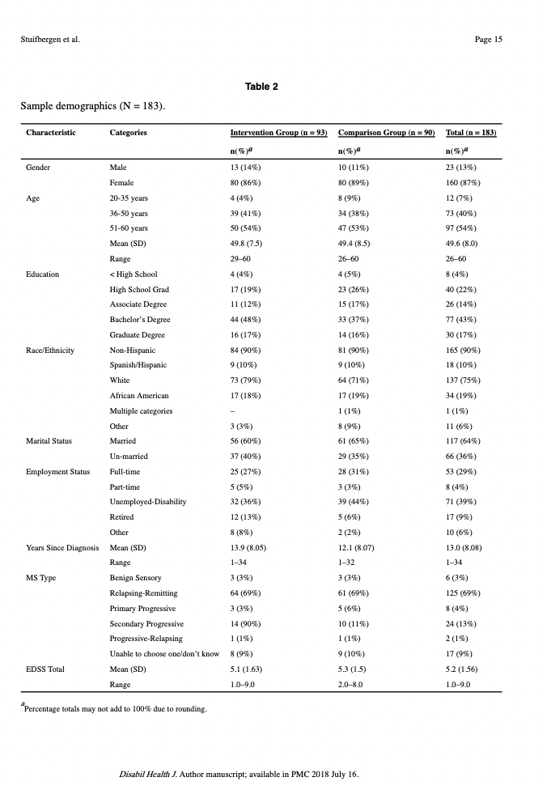
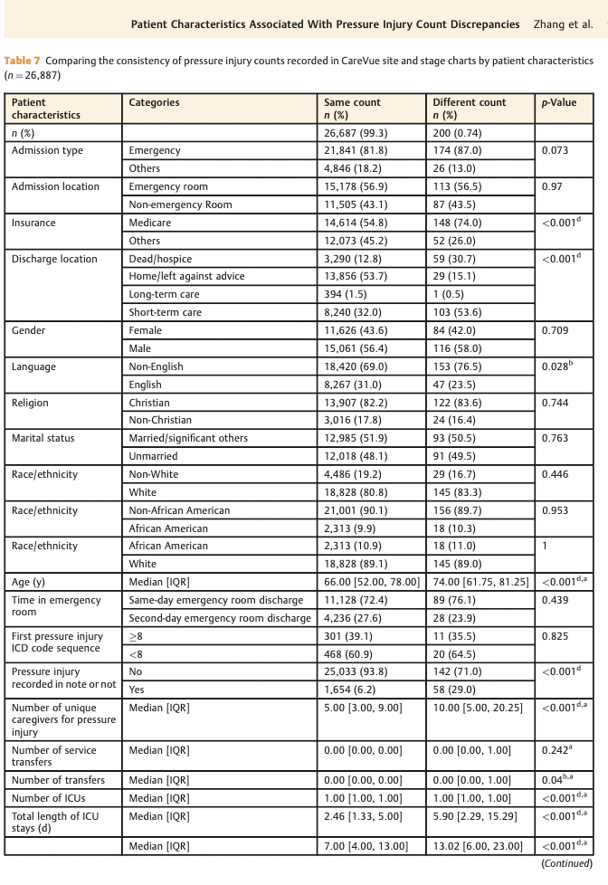
Sample demographic/characteristics
Notes:
Zhang W, Radhakrishnan K, Becker H, Acton GJ, Holahan CK. Self-Regulation Strategies as Predictors: Managing Multimorbidities Among Community-Dwelling People Aging with Arthritis. West J Nurs Res. 2020 Sep;42(9):698-707. doi: 10.1177/0193945919893679. Epub 2020 Jan 16. PMID: 31941422.
Zhang W, Sotoodeh M, Ho JC, Simpson RL, Hertzberg VS. Examining the Concordance in the Documented Pressure Injury Site, Stage, and Count in Medical Information Mart for Intensive Care-III. Appl Clin Inform. 2021 Aug;12(4):897-909. doi: 10.1055/s-0041-1735179. Epub 2021 Sep 29. PMID: 34587637; PMCID: PMC8481012.
Stuifbergen AK, Becker H, Perez F, Morrison J, Brown A, Kullberg V, Zhang W. Computer-assisted cognitive rehabilitation in persons with multiple sclerosis: Results of a multi-site randomized controlled trial with six month follow-up. Disabil Health J. 2018 Jul;11(3):427-434. doi: 10.1016/j.dhjo.2018.02.001. Epub 2018 Feb 16. PMID: 29477372; PMCID: PMC6047944.

Slide 41
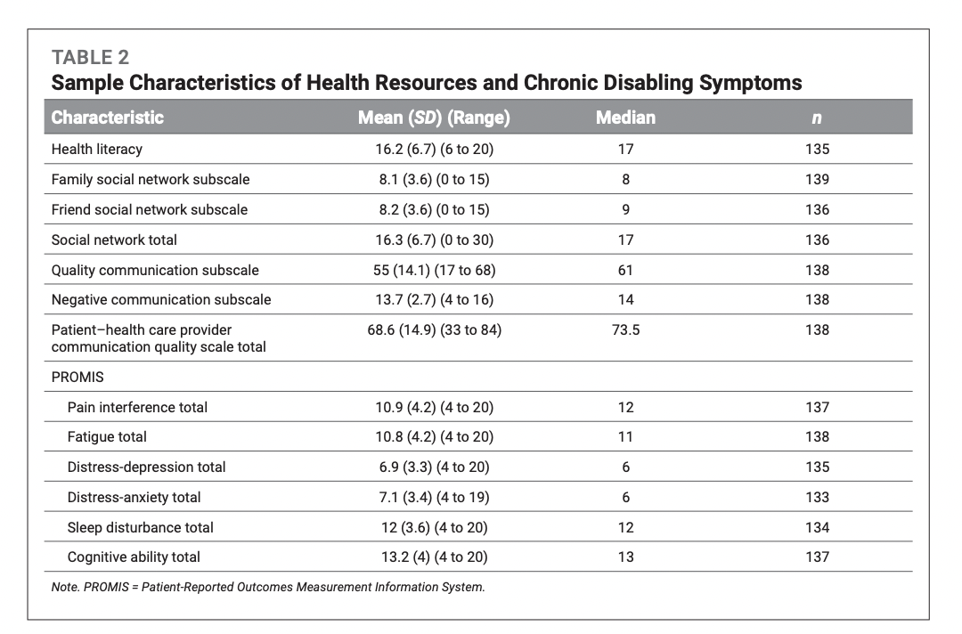
Sample demographic/characteristics
Notes:
Zhang W, Radhakrishnan K, Becker H, Acton GJ, Holahan CK. Self-Regulation Strategies Among Community-Dwelling People Aging With Arthritis and Multimorbidity. J Gerontol Nurs. 2021 Jan 1;47(1):35-45. doi: 10.3928/00989134-20201209-03. PMID: 33377983.

Slide 42
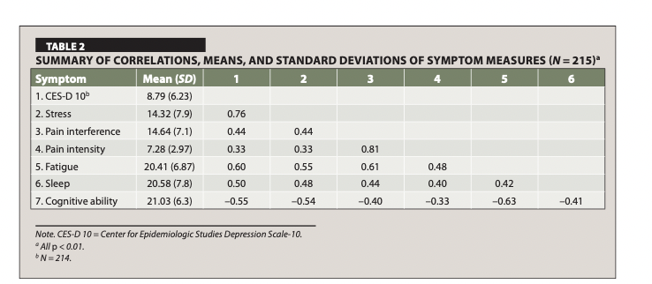
Correlation table
Notes:
Zhang W, Becker H, Stuifbergen AK, Brown A. Predicting Health Promotion and Quality of Life With Symptom Clusters and Social Supports Among Older Adults With Multiple Sclerosis. J Gerontol Nurs. 2017 Oct 1;43(10):27-36. doi: 10.3928/00989134-20170406-04. Epub 2017 Apr 11. Erratum in: J Gerontol Nurs. 2018 Jun 1;44(6):5. PMID: 28399316.

Slide 43
Questions? Thank you!

